Slide 1




Mind-Care AI
Duy Thuan Bui
Chun Yu Huang
Chen Wei Kao
Eric Quan
Yuan Jr Yang
Alec Zabala
Team: Ai Mavericks
Notes:
Good morning/afternoon everyone. We are Team AI Mavericks, and today we’re excited to introduce Mind-Care AI — an AI-powered mental health chatbot designed to provide accessible, data-driven emotional support

Slide 2
Why we want to do it
Depression:
More than 21 millions of American adults per year.
More than 3.7 millions of American youth per year.
Mental Health America (MHA) report in 2024
23.08 % of people in U.S (60 Million), experienced a mental illness in 2024.
54.7 % of adults (28 Million) with mental illness did not seek therapy in 2024.
Delayed or inaccessible treatment worsens outcomes
Notes:
The COVID-19 pandemic has further intensified mental health concerns.
(https://pubmed.ncbi.nlm.nih.gov/34655485/）
Major depression is one of the most common mental illnesses, affecting:
More than 21 millions of American adults per year.
More than 3.7 millions of American youth per year. (https://mhanational.org/conditions/depression/ )
Delayed or inaccessible treatment worsens outcomes (https://www.mentalhealthfirstaid.org/2021/06/the-importance-of-early-intervention-for-people-facing-mental-health-challenges/?)
Mental health services are not available in most of Asia, and the population usually results in self-care by not going through therapy.

Slide 3
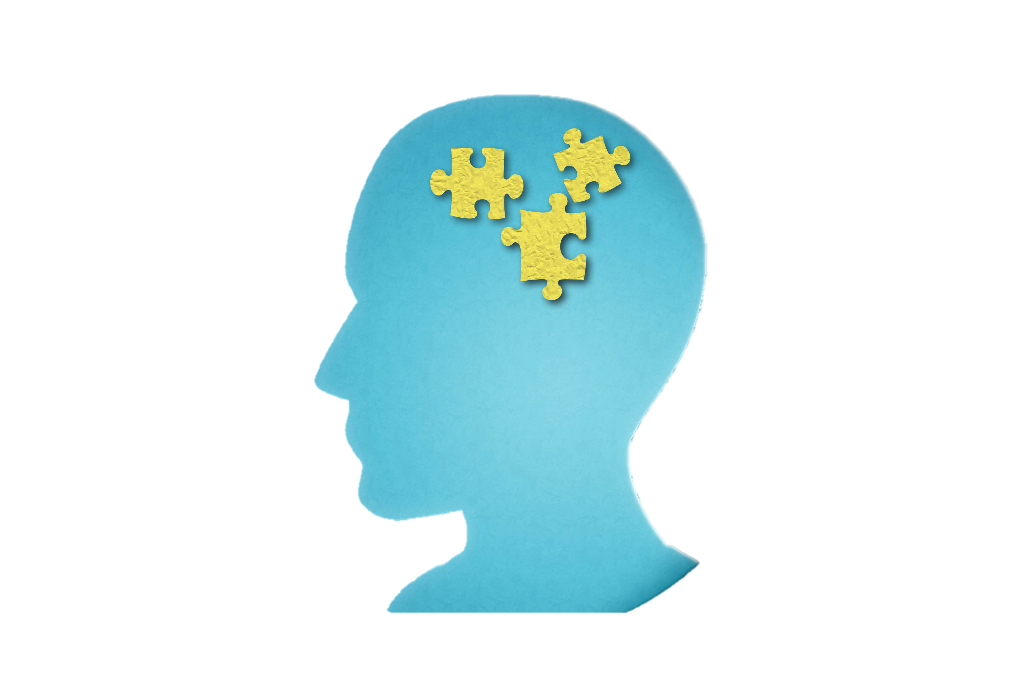

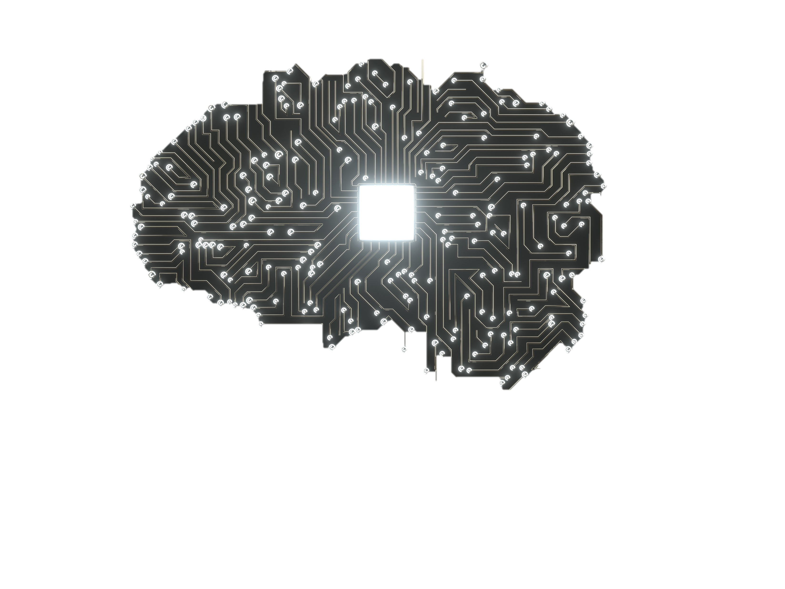
Why we want to do it
Depression
Mental Health America (MHA) report in 2024
Treatment
21 millions of American adults per year.
3.7 millions of American
youth per year.
23.08 % of people in U.S
experienced a mental
illness.
54.7 % of people in U.S
with mental illness did
not seek therapy.
Delayed or inaccessible treatment worsens outcomes.
Notes:
Mental health is a growing challenge. According to Mental Health America in 2024, over 23% of people in the U.S. — nearly 60 million — experienced mental illness, and more than 54% did not seek therapy. The COVID-19 pandemic has worsened this situation, especially in regions like Asia where access to mental health services is limited.”
“Delayed or inaccessible treatment can make conditions harder to manage, and that’s where AI-powered support can step in — offering help when people need it most
The COVID-19 pandemic has further intensified mental health concerns.
(https://pubmed.ncbi.nlm.nih.gov/34655485/）
Major depression is one of the most common mental illnesses, affecting:
More than 21 millions of American adults per year.
More than 3.7 millions of American youth per year. (https://mhanational.org/conditions/depression/ )
Delayed or inaccessible treatment worsens outcomes
23.08 % of people in U.S (60 Million), experienced a mental illness in 2024.
54.7 % of adults (28 Million) with mental illness did not seek therapy in 2024.
(https://www.mentalhealthfirstaid.org/2021/06/the-importance-of-early-intervention-for-people-facing-mental-health-challenges/?)
Mental health services are not available in most of Asia, and the population usually results in self-care by not going through therapy.

Slide 4
The COVID-19 pandemic has further intensified mental health concerns.
(https://pubmed.ncbi.nlm.nih.gov/34655485/）
Major depression is one of the most common mental illnesses, affecting:
More than 21 millions of American adults per year.
More than 3.7 millions of American youth per year. (https://mhanational.org/conditions/depression/ )
Delayed or inaccessible treatment worsens outcomes (https://www.mentalhealthfirstaid.org/2021/06/the-importance-of-early-intervention-for-people-facing-mental-health-challenges/?)
Mental health services are not available in most of Asia, and the population usually results in self-care by not going through therapy.

Slide 5
Why we want to do it?
Mental Health America (MHA) report in 2024
- 23.08% of people in U.S, experienced a mental illness in 2024 (60 Million)
- 54.7% of adults with mental illness did not seek therapy in 2024. (28 Million)

Slide 6
What is Mind-Care AI
Mind-Care Ai is AI-powered mental health chatbot designed to offer safe, empathetic and intelligent space for individuals to express their emotions.
Using NLP (Natural Language Processing), sentiment analysis, and data-driven insights, the chatbot offers a personalized, adaptive, and safe space for users to express their emotions, receive guidance, and track their mental well-being.
Notes:
Mind-Care AI is designed as a virtual mental health companion. It’s not just a chatbot — it’s a platform that listens, understands, and guides users through their emotional struggles using conversational AI, sentiment analysis, and therapy-based recommendations

Slide 7


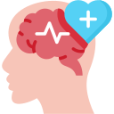

What does Mind Care AI Hope to Solve
Limited Access to Mental Support
Personalized & Scalable Mental Health Solutions
Early Detection & Mood Tracking
Stigma of Seeking Help
Notes:
Limited Access to Mental Health Support – Many individuals lack access to professional mental health resources due to high costs, geographic barriers, or stigma. Mind-Care AI provides 24/7 support, making mental healthcare more accessible.
Early Detection & Mood Tracking – Traditional therapy often lacks continuous monitoring. By using sentiment analysis and Databricks-powered mood tracking, Mind-Care AI helps users identify emotional patterns and take proactive steps.
Stigma of Seeking Help – A few individuals are hesitant to seek therapy due to social stigma. An AI chatbot offers a stigma-free, confidential space for users to express their emotions.
Personalized & Scalable Mental Health Solutions – Therapy is not a one-size-fits-all approach. Mind-Care AI personalizes responses based on user emotions, offers customized therapy techniques (CBT, mindfulness), and tracks progress over time.
We train ai to track a persons mood and to be more empathetic like natural therapist, how is this better for medical therapist we provide or ai to people who don’t have access to a ormal therapist or might not have the funds to afforad a therapist.. Or also to have a private conversation where publizied and someone who is anxious about going to a therapist

Slide 8



What is the blueprint for Mind-Care AI
B2C
B2B
Development​
Notes:
B2C
Monthly subscription (e.g., $5–$10/month)
• Free version includes basic chatbot interactions and daily mood tracking
• Premium version includes:
• Personalized mood and mental health reports
• Advanced CBT and mindfulness modules
• Weekly live Q&A or text responses from certified therapists
B2B
• License the chatbot to companies, universities, or large organizations
• Offered as an “Employee Mental Wellness Tool”
• Helps reduce stress, burnout, and sick leave among employees
• Provide report regarding company's employees, anonymous.
• Pricing by annual contract or per user (e.g., $2/user/month)
Medical business that specialize in mental health servces
Development
• Provide an Application Programming Interface(API) for integration into existing mental health platforms, insurance portals, or health check services
• Revenue generated by usage-based pricing or monthly API plans

Slide 9
Data
We got sources from professional resources using Google Scholar and saved our sources to Google Drive and Pinecone. After we store sources in Pinecone retrieved from Google Scholar, we embed sources to OpenAI so the AI can give outputs like ChatGPT using N8N.
Use Kaggle Dataset for written responses determining suicide

Slide 10
Data
3 variables: number, text, target variables (Suicide and non-suicide)
# | text context extracted from user posts(Input) | class target variable
1 | Ex Wife Threatening SuicideRecently I left my wife for good because she has cheated on me twice and ... | suicide
2 | Am I weird I don't get affected by compliments if it's coming from someone I know irl but I feel rea...non-suicide | non-suicide

Slide 11
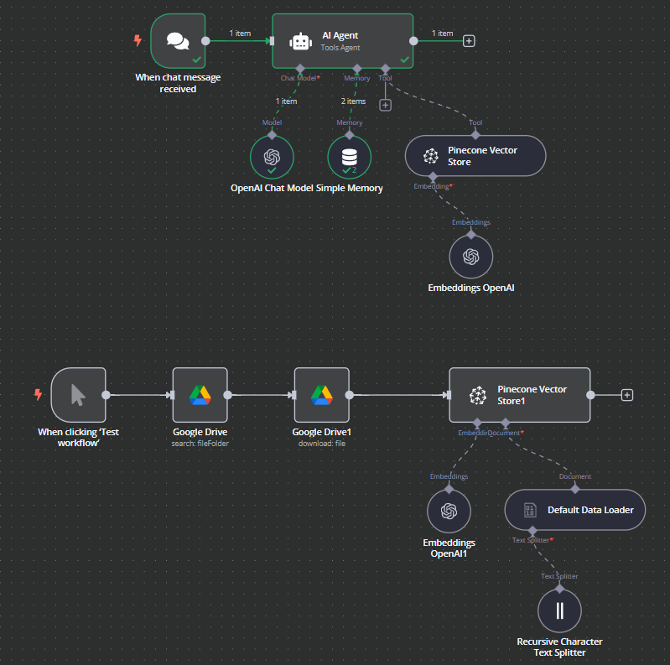
Prototype/Workflow (N8N)

Slide 12
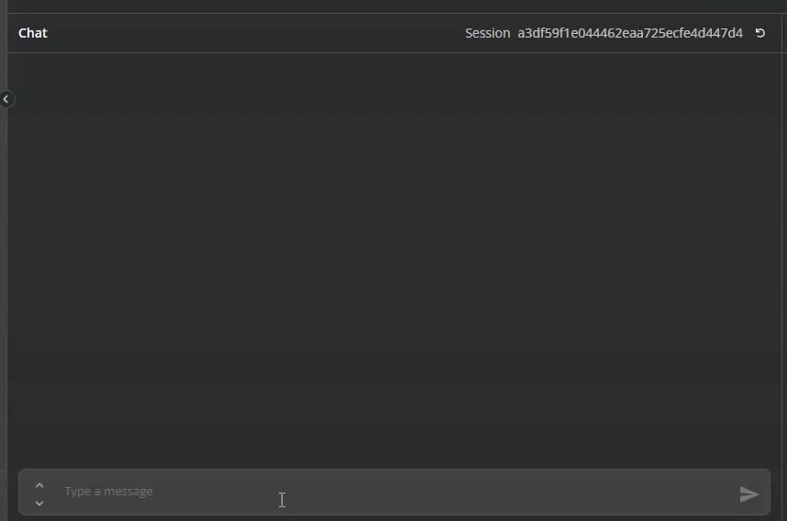
Demo
Notes:
Short demo of bot and we can add more stuff in the future. This is a medical chat bot. Its different then normal AI bot because we will be training it and putting medical articles will be more medical specific just like the big database that doctors use when they treat their patienss.

Slide 13
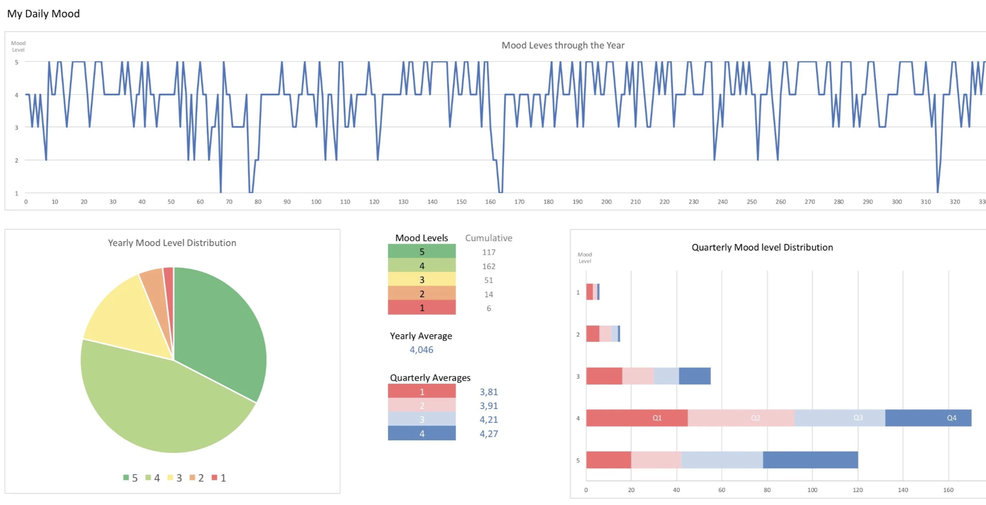

In the Future!
Crisis Intervention & Support
Data-Driven Mental Health Insights
Insurance & Healthcare Partnerships
Future Scalability with Emerging Tech
Notes:
Talk about:
Datasets from online sources of text relating to suicide will be incorporated for determining life threatening situations for a person to reach out to mental health offices.
When a person asks for theie daily mood tracker a dashboard would be displayed through analyzing the persons mood
Collaborate with insurance companies and healthcare providers
Offer the chatbot as part of a preventive care package
Users can earn “wellness points” through engagement that translate into discounts on premiums
VR integration where you can talk to a virtual therapist in the future

Slide 14

The end
Thanks for watching. Come back for the next idea we have.

Slide 15
Source
https://mhanational.org/the-state-of-mental-health-in-america/
https://pmc.ncbi.nlm.nih.gov/articles/PMC1489866/
https://mhanational.org/conditions/depression/

